Slide 1
SWOT Analysis - Tech Team
A SWOT analysis can be a highly useful tool for determining how any technical support system is faring. SWOT, which stands for strengths, weaknesses, opportunities and threats, tells you how support services are doing today and how you can best make changes to adapt to the future. Strengths and weaknesses identify internal conditions, while opportunities and threats deal with external changes that your tech support operations will need to face in the future.
Coming together is a beginning; Keeping together is progress; Working together is success.

Slide 2
 | Helpful | Harmful
Internal | Strengths | Weaknesses
External | Opportunities | Threats
Coming together is a beginning; Keeping together is progress; Working together is success.

Slide 3

Summary :
Based on the one on one discussion with the team members, I have listed
the SWOT details for our tech Team.
This will also be carried out as a team building activity to know more SWOT.
Time to check the SWOT Analysis…..
Let’s Goooooooooooo………..
Coming together is a beginning; Keeping together is progress; Working together is success.

Slide 4








S
Strengths
Fast Learner, Go getter, Down to earth.
Great Energy.
High on motivation.
Ready to take Responsibility.
Want to Prove attitude.
W
Weaknesses
They can not say NO.
360 degree thinking for implementation.
Just do it attitude.
System knowledge.
O
Opportunities
More Team bonding activities required.
Want to lead team.
Want to make changes to architecture for scaling.
Improving major component.
Static to Dynamic Shift.
Saturday should be no development or should have other activity like planning/grooming/upgrading etc or a holiday. Since 5 days are too heavily on coding and releasing.
T
Threats
No documentation, Difficult to understand the Code.
Requirements are Never Frozen.
High Calibre people are doing static Content updates.
Doing Static Work all the time.
No process followed
No impact analysis is done on the things gone live.
Weekend Release or release before public holidays.

Slide 5
Action Plan
Weaknesses :
Team Member have been give key points on how to work on the Weaknesses. Few points are work in progress.
Opportunities :
Few of the team Member have already be assigned required task for high efficiency. Over the next 6 months plan is the enhance these opportunities and maximize them for the team.
Threats :
Introducing New process. Setting SOP and POC to reduce the impact of these threats. Planning to
Move from Static to Dynamic work. Repetitive Activities to have a New ETA for Static to Dynamic Shift.
Coming together is a beginning; Keeping together is progress; Working together is success.

Slide 6
Designation Update - Skills are given as designation. Must be changed.
Team Member Name | Current Designation - Fitternitty | Recommended Designation | Short Form
XXXXX XXX | Sr Software Engineer | Software Development Engineer Level 3 | SDE |||
XXXXX XXX | Sr.Backend Developer | Software Development Engineer Level 2 | SDE II
XXXXX XXX | Frontend Developer | Software Development Engineer Level 2 | SDE II
XXXXX XXX | Frontend Developer | Software Development Engineer Level 2 | SDE II
XXXXX XXX | Nodejs Developer | Software Development Engineer Level 2 | SDE II
XXXXX XXX | Backend NodeJS | Software Development Engineer Level 2 | SDE II
XXXXX XXX | Software Engineering | Software Development Engineer Level 2 | SDE II
XXXXX XXX | php developer | Software Development Engineer Level 3 | SDE III
XXXXX XXX | iOS Developer | Lead Software Engineer - Mobile application Level || | LSE ||
XXXXX XXX | Sr Android Developer | Software Development Engineer Level 2 | SDE II
XXXXX XXX | Asso Android Developer | Software Development Engineer Level 1 | SDE I
XXXXX XXX | Sr Software Tester / Mobile | Software Development Engineer Level 3 | SDE III
XXXXX XXX | Php Developer | Software Development Engineer Level 2 | SDE II

Slide 7
KRA & KPI for the Tech Team
KRA : A good KRA includes the ongoing responsibilities of the position, and the purpose and benefits of performing those responsibilities. Tasks and activities that focus on one or more specific areas are grouped together.
KPI : A quantifiable measure used to evaluate the success of an organization, employee, etc. in meeting objectives for performance.
Details of the KRA & KPIs are listed below for the Tech Team.
Coming together is a beginning; Keeping together is progress; Working together is success.

Slide 8
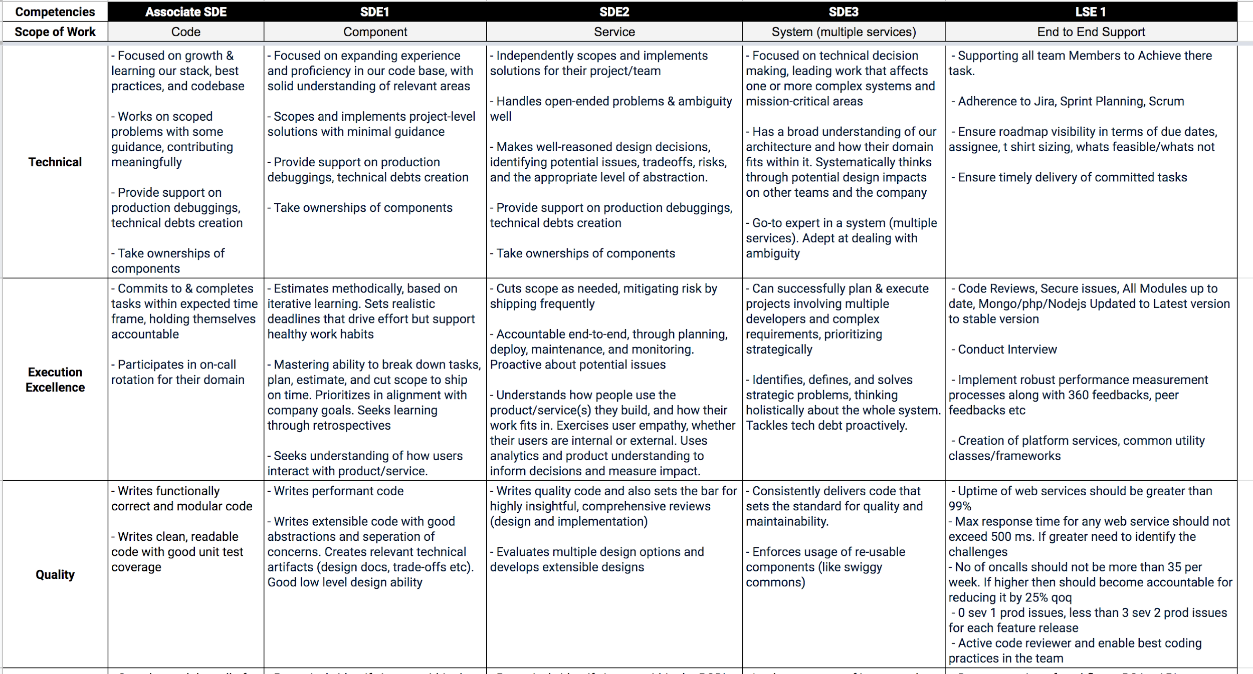
KRA - Key Responsibility Areas for the Tech Team.

Slide 9
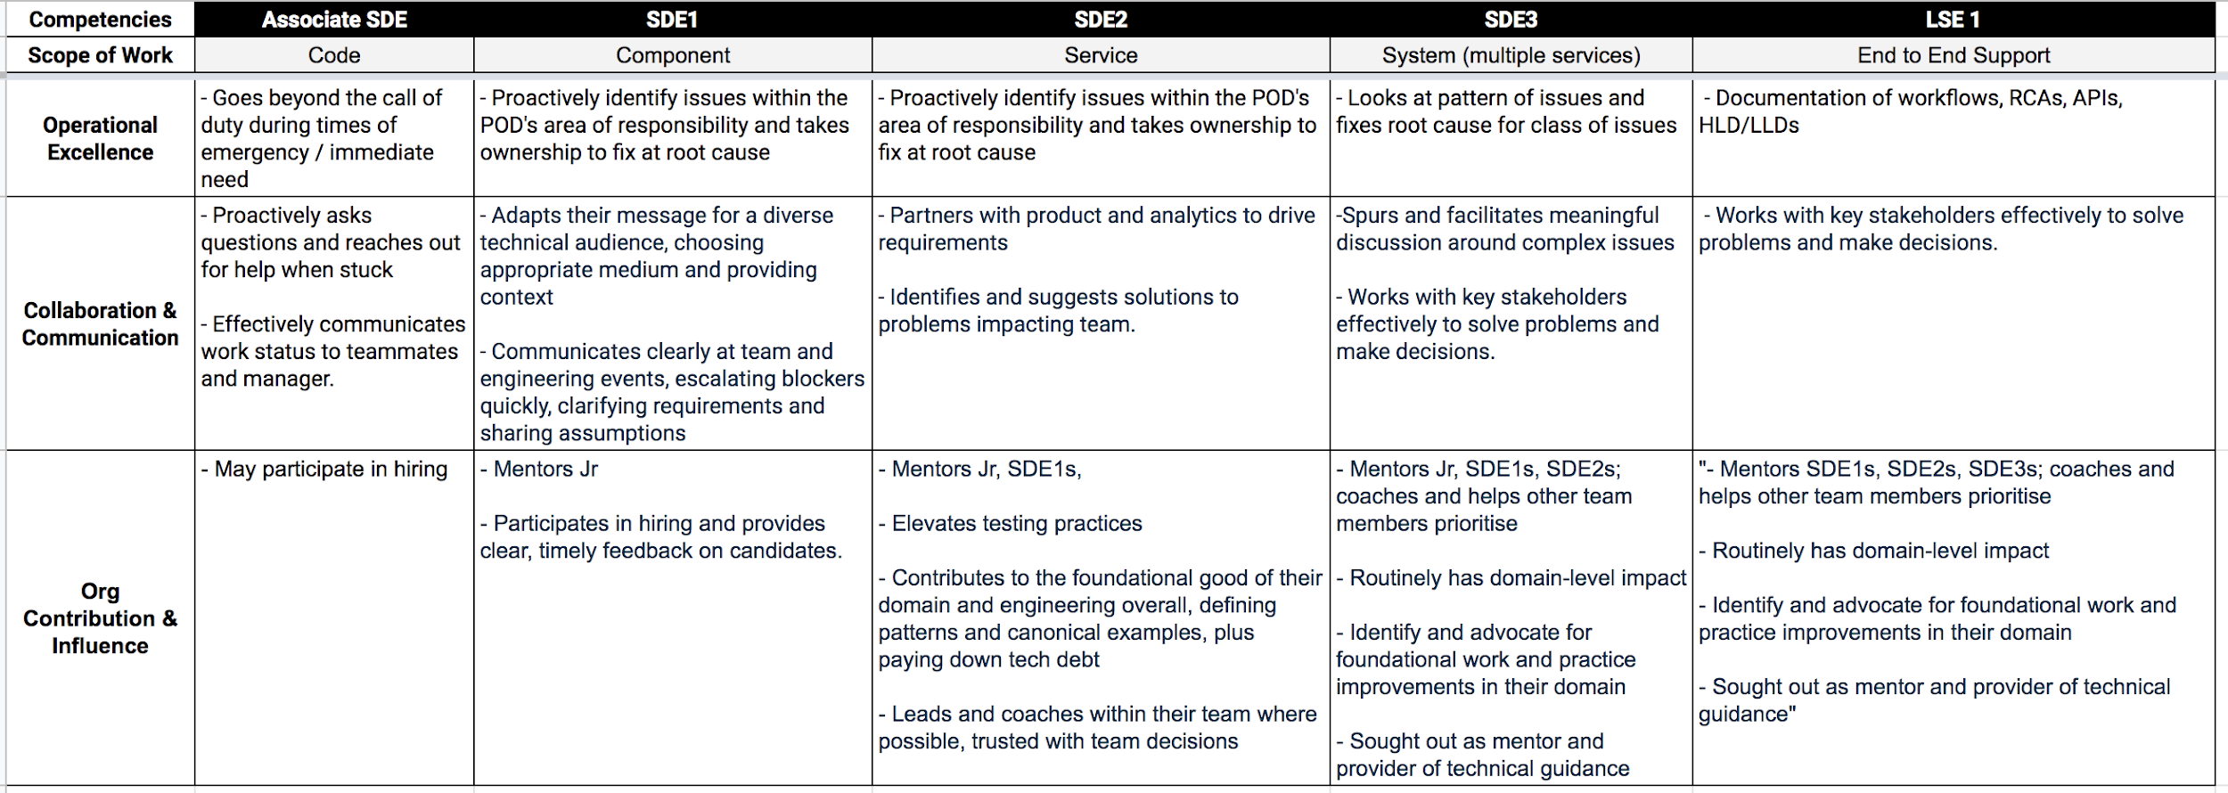

Slide 10

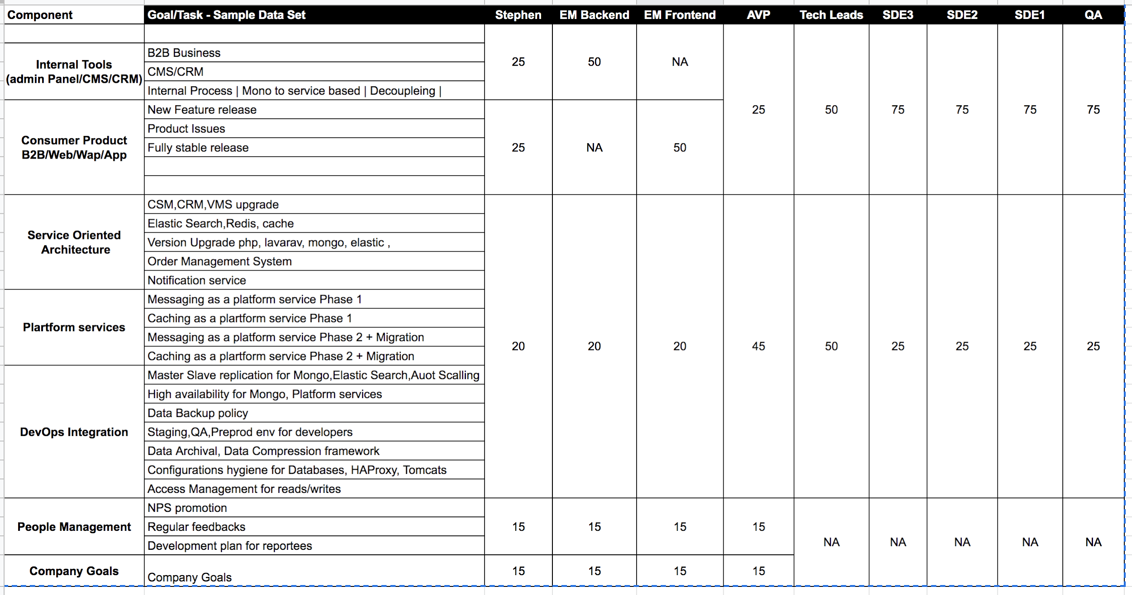
KPI's - Key performance Indicator
HOD

Slide 11
Need Closer on the below Points
Designation Update :
This is important to update as the current designation are not up to the market standards. Most of the designation are Skills.
KRAs & KPIs :
This is important to be shared with Each and every team member so that they are clear as to what is expected from them. Quarter reviews of the KPIs will be conducted and a rating will be issued to each team member and will be shared with them so that they can improve on the areas in which they have scored less. Suming of all the 4 Quarter will give us a final rating for the appraisal in April 2021.
Coming together is a beginning; Keeping together is progress; Working together is success.

Slide 12
New Seating Arrangement -
As per there Groups - API/CMS/Search/Frontend/Node/php/Project/Product/Design/QA
CEO
 |  |  |  | Core Team
Design | Design |  |  | Frontend Team
QA | QA
App Team |  |  |  | Backend Team
Coming together is a beginning; Keeping together is progress; Working together is success.

Slide 13

Coming together is a beginning; Keeping together is progress; Working together is success.

